Slide 1
DevSecOps
Pulkit Kumar

Slide 2
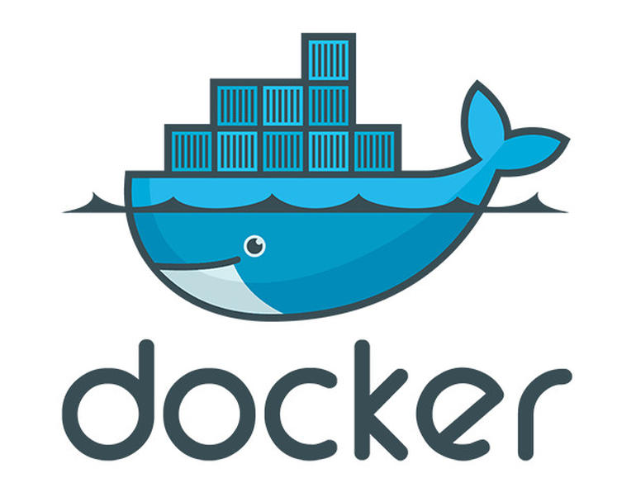




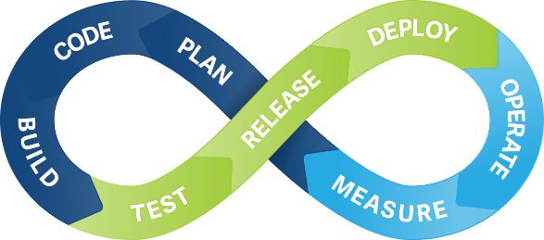


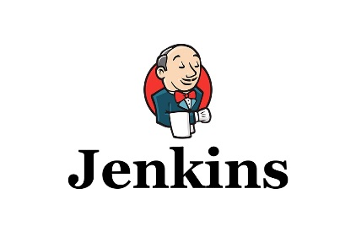

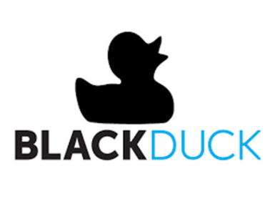
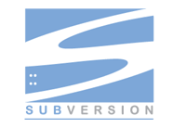
DevSecOps - CI process with Security checks
Code development – in IDE
SVN Checkin
Jenkins – Dev Build
Secure Assist – in IDE – Catch Vulnerabilities at project level
Code Coverage Check from IDE – Target 90-95%
Jenkins CI- Additional check with Coverity & Black Duck Opensource Scan
Jenkins – Deploy (By Developer)
Jenkins – Deploy (By Dev Ops)
Code development – in IDE
SVN Checkin
Jenkins – Dev Build
Secure Assist – in IDE – Catch Vulnerabilities at project level
Code Coverage Check from IDE – Target 90-95%
Jenkins CI- Additional check with Coverity & Black Duck Opensource Scan
Jenkins – Deploy (By Developer)
Jenkins – Deploy (By Dev Ops)
Jenkins Dev build
Binary built in Jenkins and copied to File server
Docker script creates the docker image
Jenkins – Deploy (By Developer)
Deploys on the target env – Dev
Jenkins – Deploy (By Dev Ops)
Pre-built Dev Image deployed to target environment

Slide 3
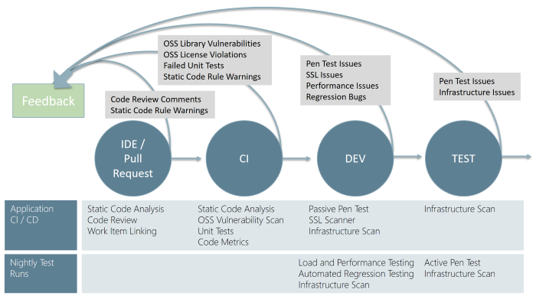
DevSecOps - Continuous security validation to CI/CD pipeline – Industry Recommendations
DevSecOps incorporates the security team and their capabilities into the DevOps practices making security a responsibility of everyone on the team
Security needs to shift from an afterthought to being evaluated at every step of the process.
Securing applications is a continuous process that encompasses secure infrastructure, designing an architecture with layered security, continuous security validation, and monitoring for attacks.

Slide 4
Appendix

Slide 5
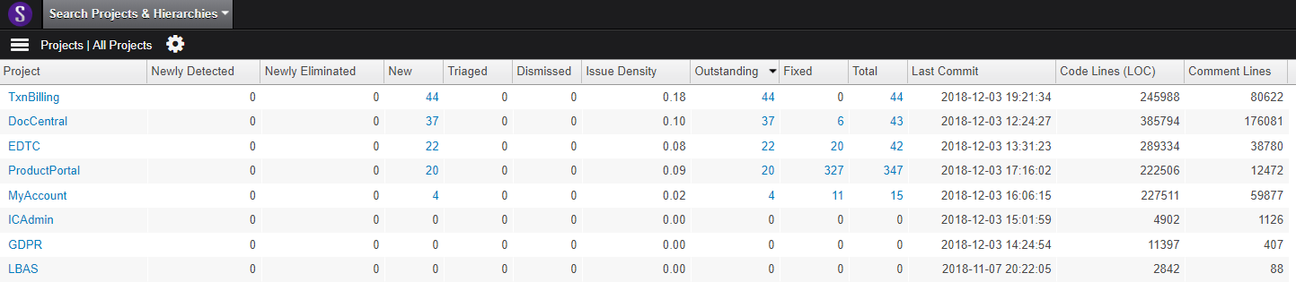
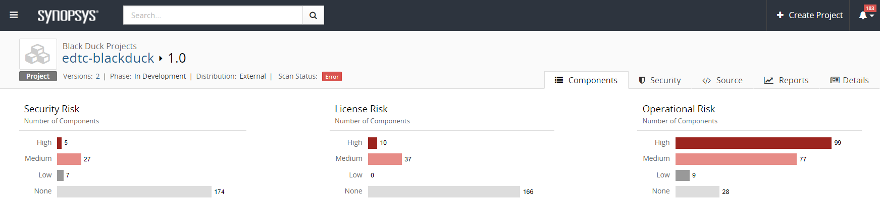
Coverity and BlackDuck in CI/CD
Pipeline jobs are configured to pull the code from Source Code Repository (SVN) and does the scan using Coverity software and Blackduck Detect.
Blackduck hub plugin for Jenkins is used to do detect open source libraries and Windows Batch Commands are used for static code analysis.
Scan results are published to Coverity and Blackduck dashboards which are running on respective host machines in AWS.
Dashboards are accessible from any web browser which is configured through AWS Route 53 URL’s.
Application specific users are created for the Developers to access the dashboards and address the issues.

Slide 6
DevSecOps: Process description
IDE / Commit request to Source code repository
Validation in the CI/CD begins before the developer commits his or her code. Secure Assist in the IDE provides the first line of defense related to security vulnerabilities
Both SecureAssist and Coverity use “checkers” to identify the various classes of vulnerabilities and BlackDuck detects the open source libraries
Secure Assist is available (only) in the IDE of developer
Checks for new checkers every time the IDE is restarted
No action from developers to access the updates.
SecureAssist’s checkers are updated 2-3 times/year as part of standard maintenance updates
For, Coverity, checkers are added/modified during quarterly product releases
Post release, new license is shared with Org. by Synopsys
Once the new licenses are loaded, all users will be using the most up-to-date Coverity version
Coverity is available both in the IDE and centralized version via Jenkins.
Cobertura and Jacoco gives the code coverage and code complexity results
During this phase, coverage is checked to meet the compliance standards

Slide 7
DevSecOps: Process description
CI/CD (Continuous Integration and Continuous Deployment)
Once the Developer commits the code to Source Code Repository (SVN), Code coverage reports are generated again from Jacoco plugin integrated to Jenkins.
A timely Jenkins job will run a Secure Assist scan through a VB script which invokes a IDE and identify the vulnerabilities and send reports with High, Medium and Low risks.
Jenkins Jobs for Coverity for static code analysis and BlackDuck scan for detecting open source libraries will be triggered in a similar fashion and the results are committed to respective dashboards.
Developers have to address the issues and re-commit the code to Source Code Repository.
Once code quality metrics are found compliant, the application is built as a docker image through Jenkins pre-configured jobs and shell scripts and deployed to the lowest environment (development)
Once the Developer gives a signoff for Dev Environment, application is ready to promote to higher environments (QA-STG-Prod)
After the application (docker image) is deployed to Quality Analysis, QA Team performs Unit, Integration, Sanity, Regression testing etc.
Once QA sign off, same docker image will be deployed to Production Environment on a scheduled window.

